Slide 1
Good Morning!

Slide 2
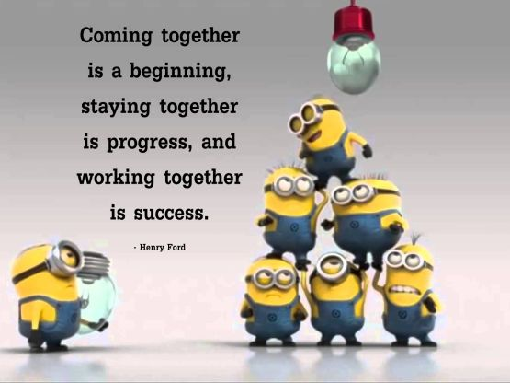
Quote for the day!

Slide 3
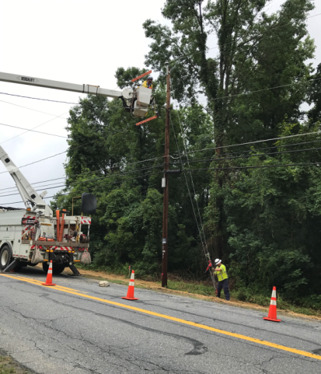
Planning vs Construction
Next are a few advance utility relocation projects that were completed this past year to compare how well our design/planning came together once the project went into construction.

Slide 4
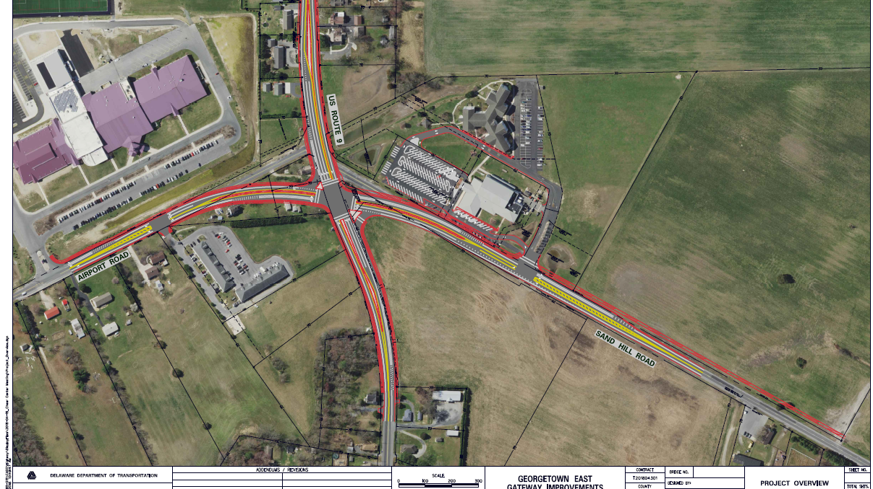
Georgetown East Gateway

Slide 5
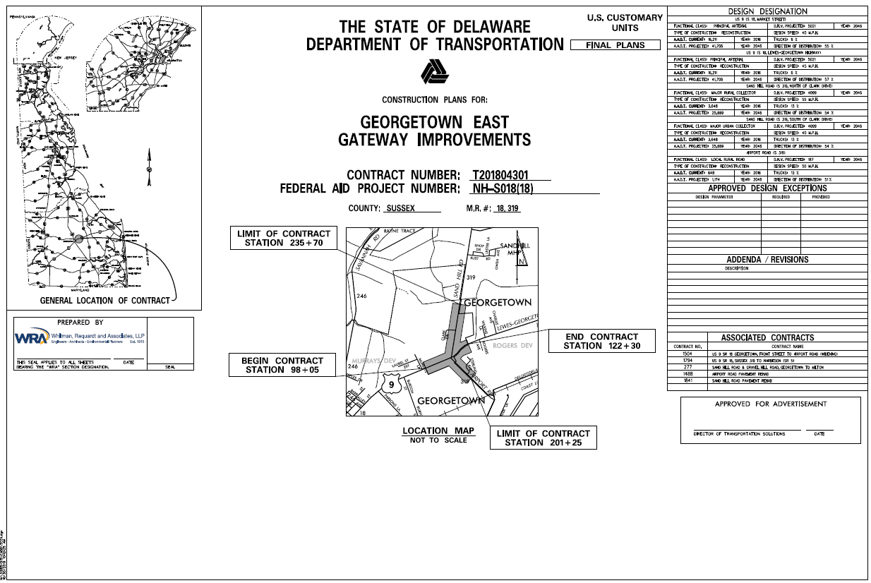
Georgetown East Gateway
Project was to realign Sand Hill Road and Airport Road to intersect US 9 at one location at an improved angle.
Other improvements include intersection turn lanes, pedestrian and bicycle facilities, and drainage improvements.
Sussex Academy on one corner of the intersection and the CHEER Center on another corner.

Slide 6
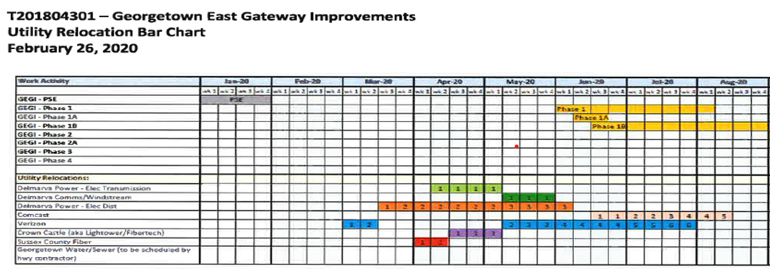
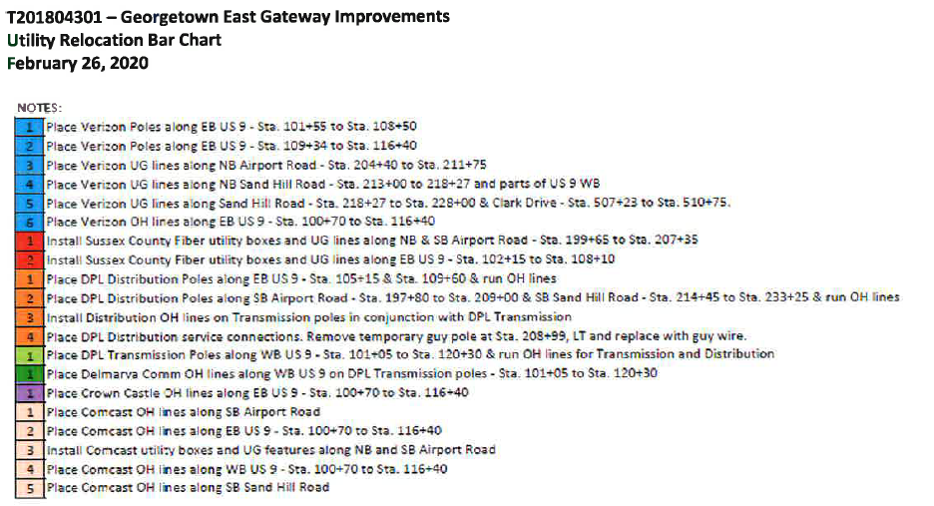
Was originally coordinated to limit road impacts to be outside of school year under tight timeline.
COVID eased need for this some.
Large majority of utility work was to occur in advance as the above schedule shows.

Slide 7
Things Didn’t Go as Planned
Here is the actual relocation schedule.
The advanced utility inspection and the highway inspection were performed by KCI. The advanced inspection was very beneficial.
Additional clearing needs were discovered in field and handled quickly.
Additional coordination with existing signal and electric service was needed in field. Utilities had to get out from under existing signal span wire and around an existing signal pole. Good teamwork between companies & DelDOT Traffic.
There were recently some conflicts discovered with Comcast and DPL-Dist around the CHEER Center that are being worked through.

Slide 8
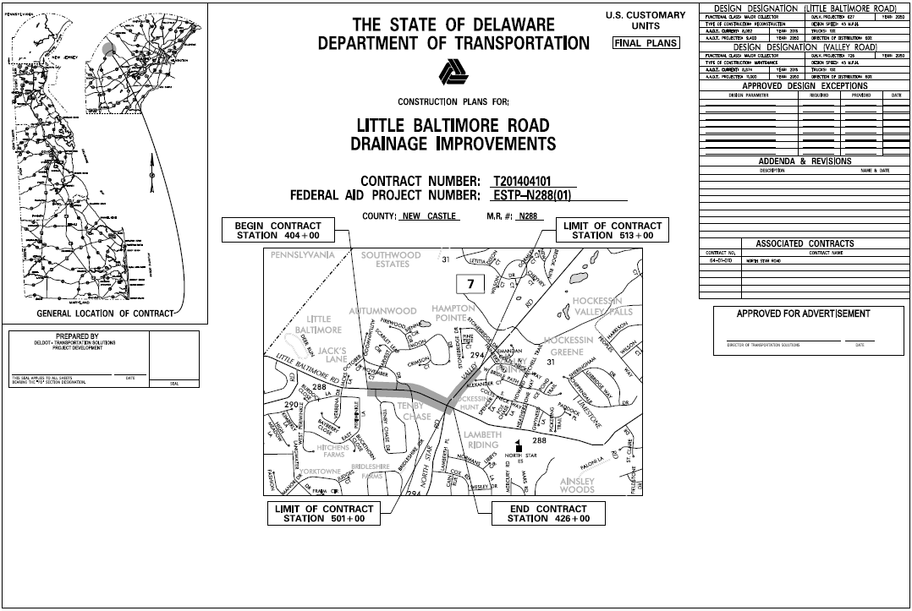
Valley Road and Little Baltimore Road Improvements
This project was to improve the drainage, pedestrian access, and replace the existing bridge.
The design required major cuts to the existing grading.
All existing utilities had to relocate their facilities.

Slide 9
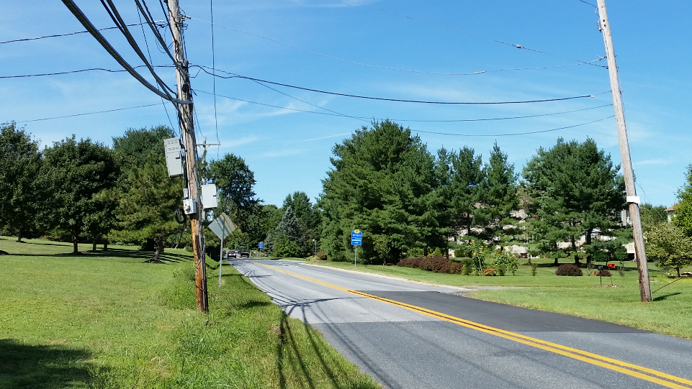
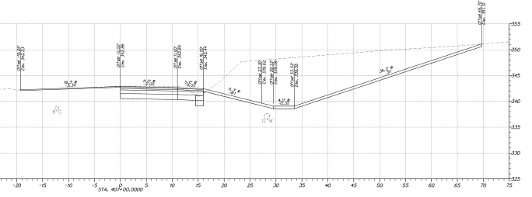
Deep Cuts Along Little Baltimore
Some cuts were 15 feet.
Advanced work meant the underground utilities had to install extra deep and the aerial utilities had to install taller poles (set deep) to accommodate final grades.

Slide 10
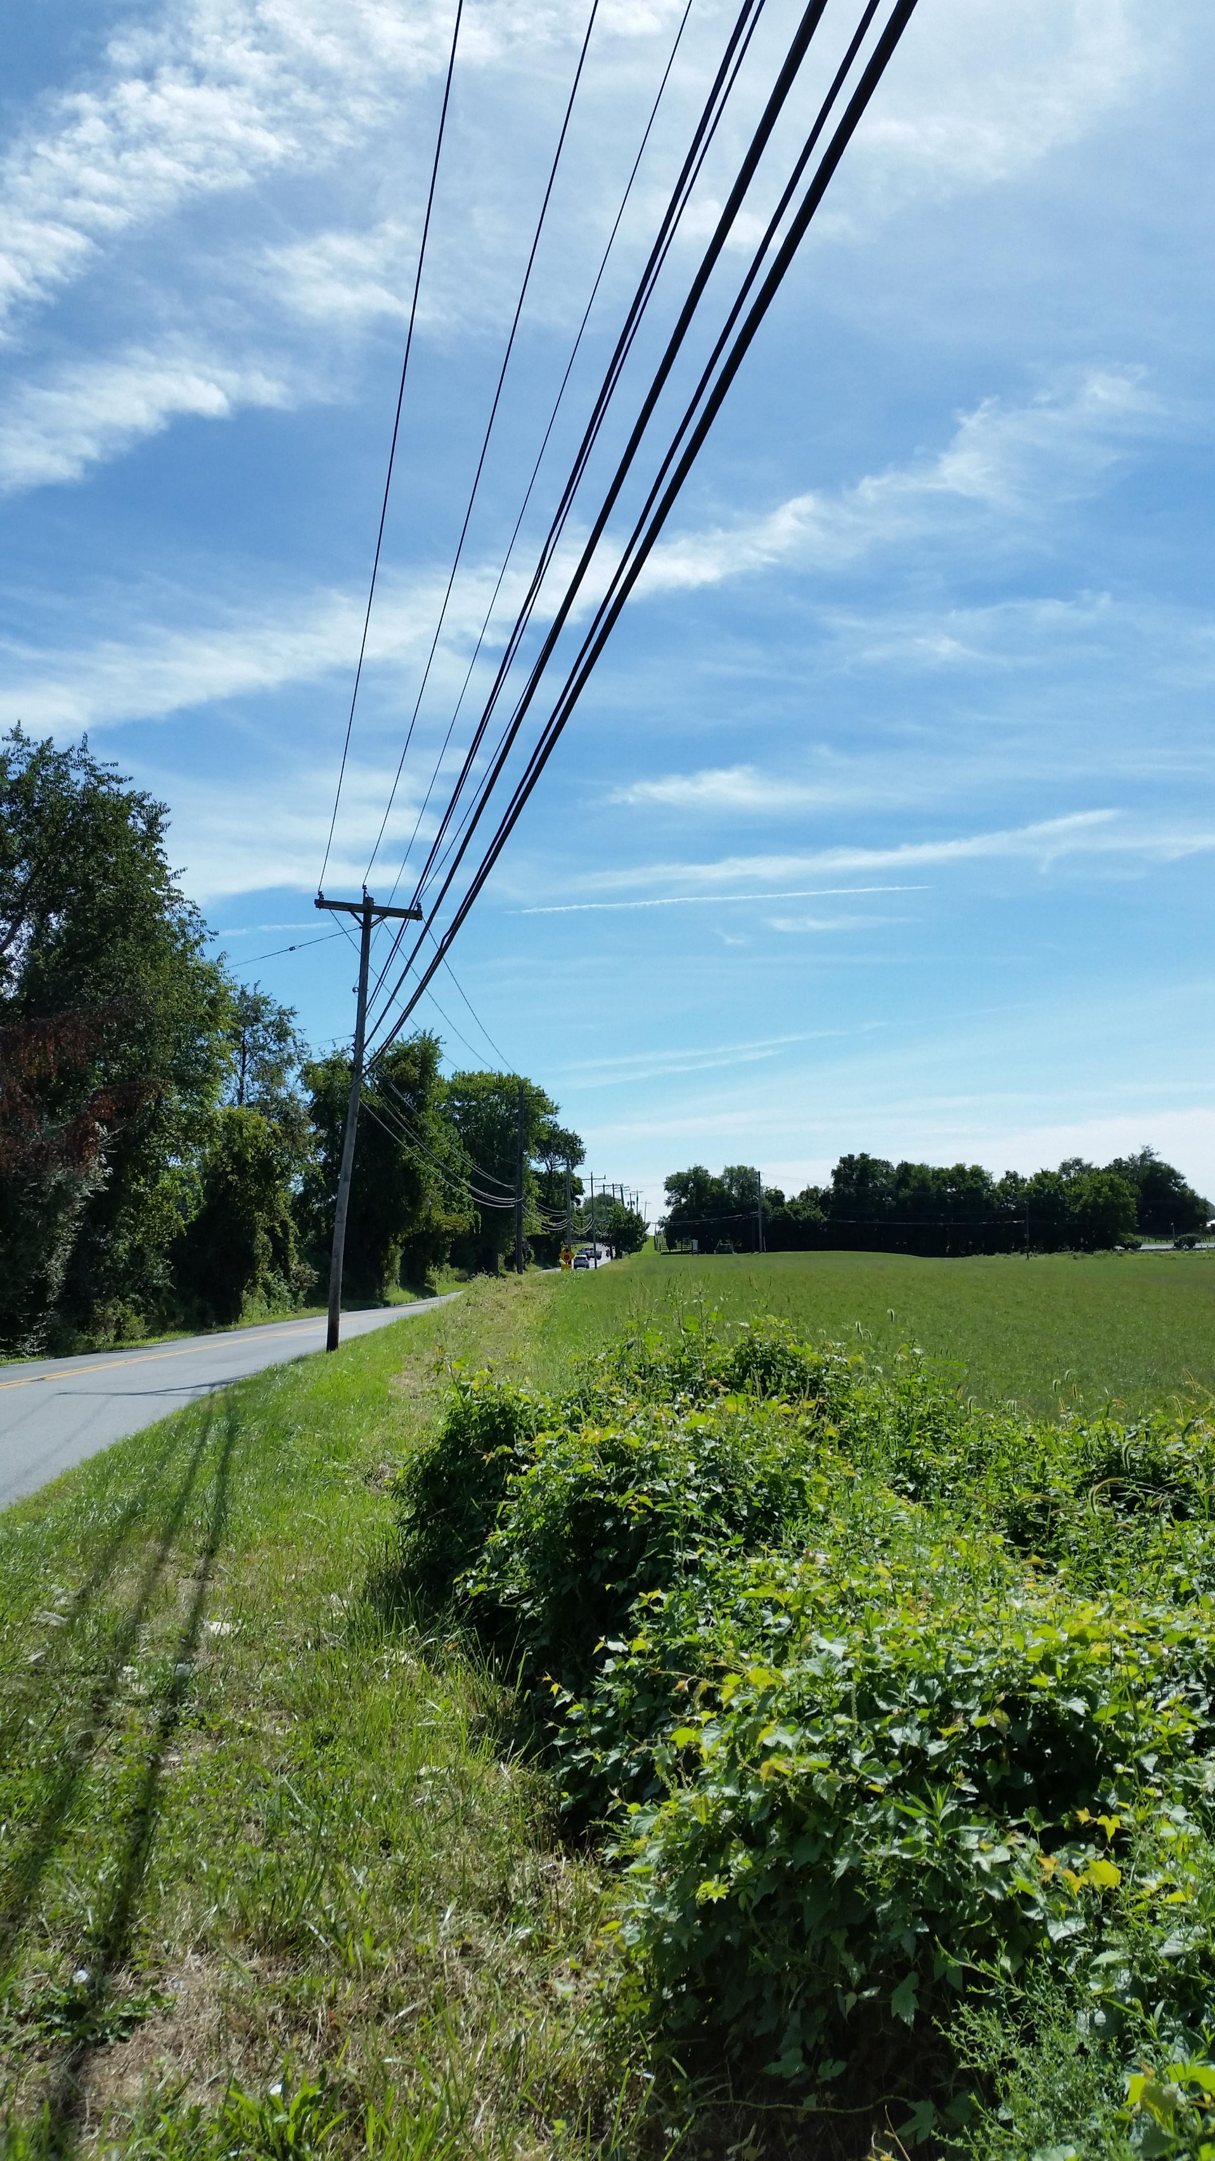
Challenges
The design team went far and beyond to see how to make this project work and be completed in a timely manner.
After many discussions, it was decided to have the utilities relocate in advance.
A clearing contractor was brought onboard by DelDOT.
A Utility Inspector was brought onboard to coordinate & oversee the project during the advance relocations.
The utility statement was written and approved by each utility. It included the relocation timing and schedule of work.

Slide 11
It was agreed that the utility relocations would occur in late spring/early summer to allow the State’s contractor to perform the road widening beginning in the summer months.
See the utility bar chart below.
All’s A Go!
Notice to Proceeds were sent and the utility relocations were ready to start.

Slide 12
Actual Relocation Schedule
Wait A Minute!
As with all best plans we had a few hiccups along the way.
The utility statement wasn’t finalized until May 24, 2019.
Cost estimates weren’t received on time.
Signed agreements weren’t received before DelDOT’s fiscal year ended which delayed sending out the NTP’s.
Clearing Contractor was delayed.
Utility Companies waited to design and process their internal designs for construction until after the NTP’s were received.
Utility Companies waited long after NTP was received to bid work out.
What happened?
It was DelDOT’s understanding that once the advance notice is received, the utility company will be on site as outlined in the agreed upon Utility Statement and relocation schedule. This was not the case.

Slide 13
See the actual relocation schedule below.
Even though we had delays, this project was only delayed by 2 or 3 weeks later than the anticipated state contractor construction start date.

Slide 14
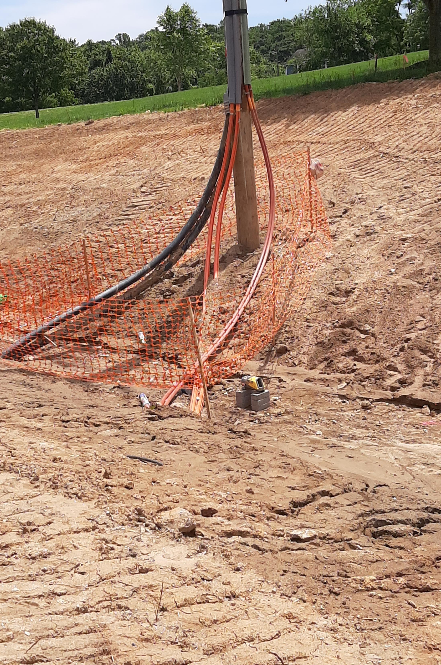
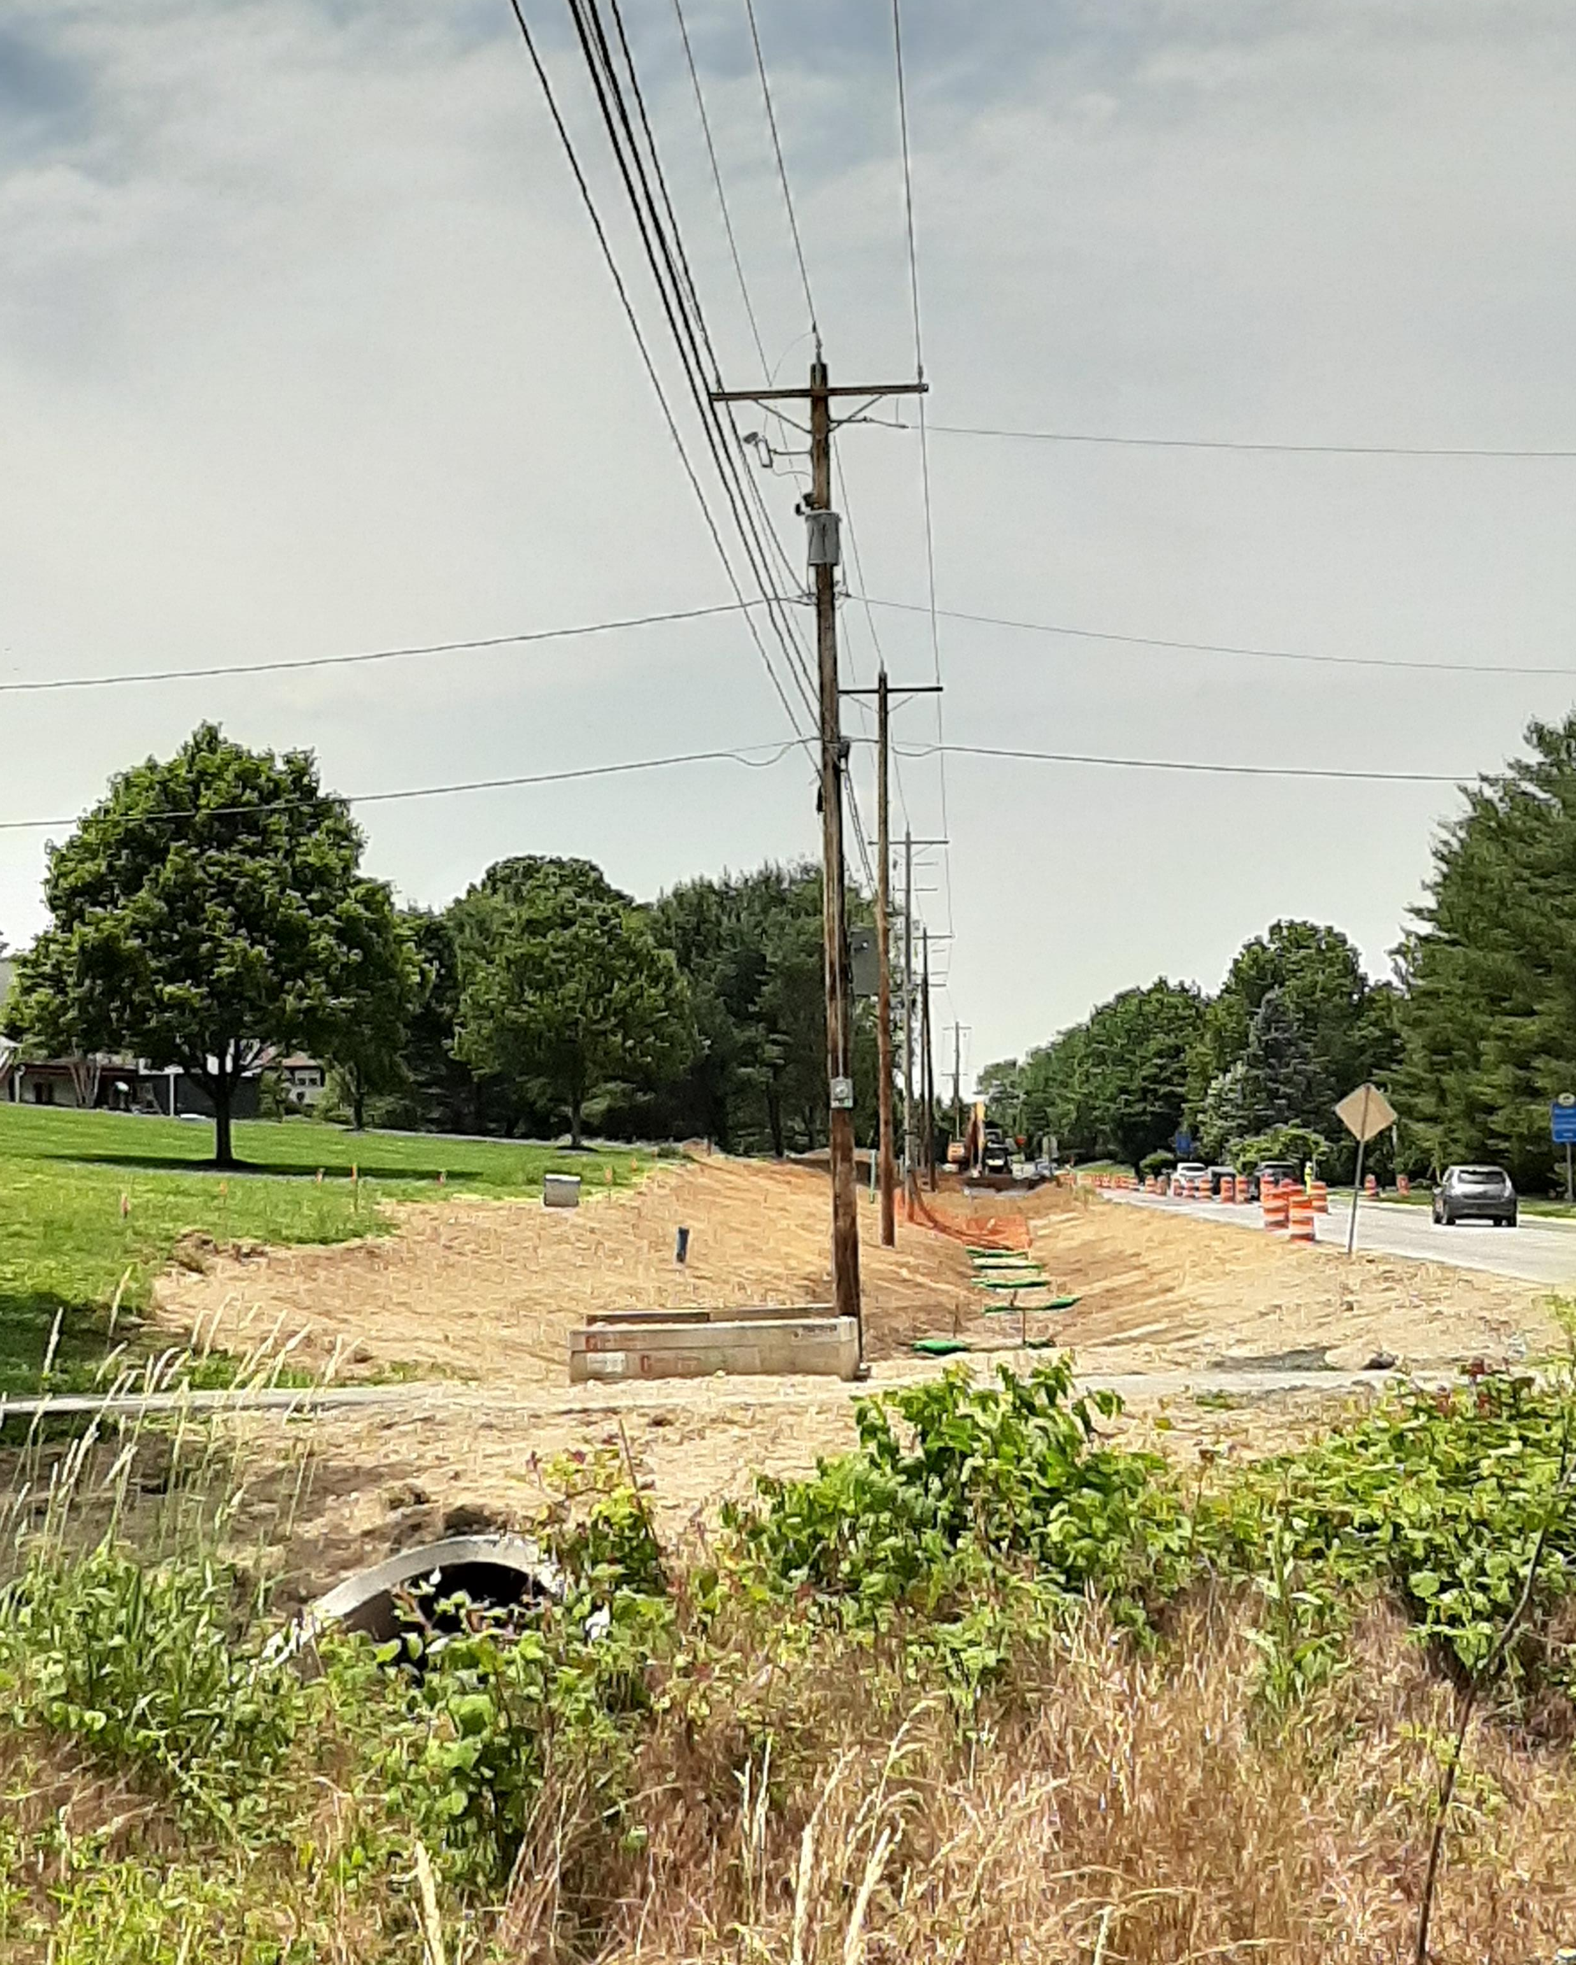
Construction Was Underway
Underground electric and communications conduits were exposed and had to be lowered during construction.
Delmarva Power Electric, Comcast, and Verizon met on site to scheduled the work. It was great teamwork to have the conduits lowered.
DelDOT’s contractor changed the bridge construction to a pre-cast structure requiring Delmarva Power to provide an outage that was not planned or anticipated during design.
The gas main was hit and needed to be repaired.

Slide 15
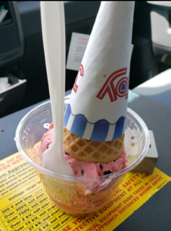
Benefits of this Project
Supporting the local businesses
Decorating for Christmas

Slide 16
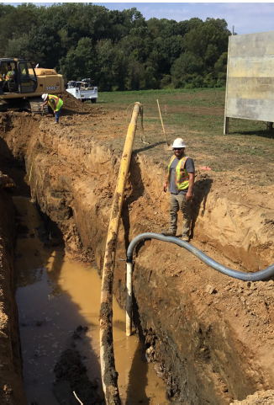
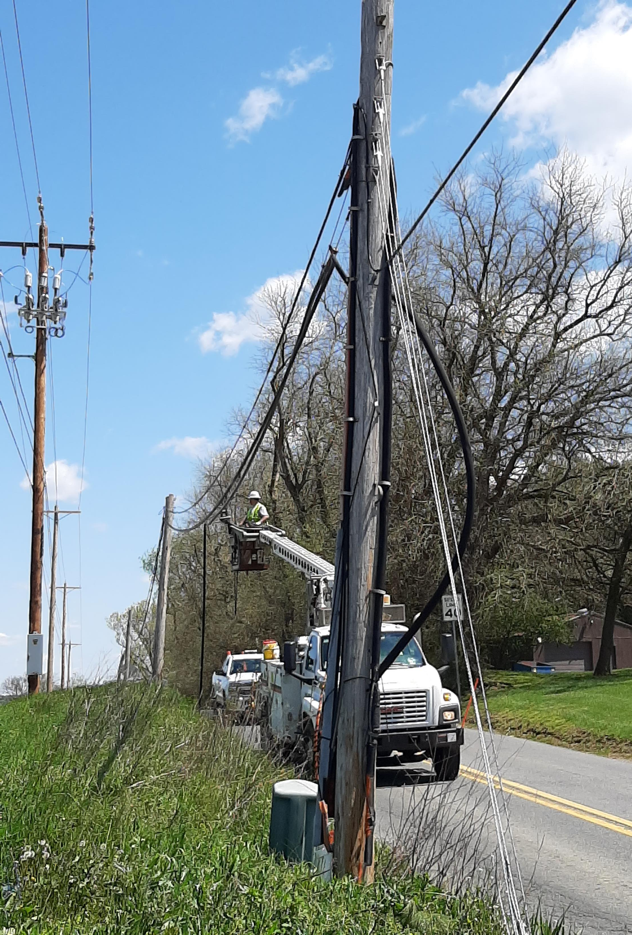
SUCCESS!
On-site utility coordination and inspection was performed by Century’s Steve Chantry. He was able to keep the project moving. Thank you!
A big THANK YOU to Tom Smith (DP-E), Darren Marsteller (Comcast/Americomm), John Raudenbush (Verizon), Wayne Tyler (AWC), Laszlo Keszler (DP-G) for all the additional work coordination that occurred during design and throughout the relocation and construction process.
Thank you to Eastern Shore Natural Gas for coordinating with us to remain in place.
It took a lot of extra work to complete the project. It was a great job, though a little over the planned completion date.

Slide 17
Pyles Ford Road Culvert Replacements
This project was first started in 2005. DelDOT planned to replace the existing culverts with precast culverts, wingwalls, and riprap.

Slide 18
BR 1-085 on Pyles Ford Road
Pyles Ford Road is the home to the only triangle bridge in Delaware.
The condition of this bridge became critical and had to be addressed.

Slide 19
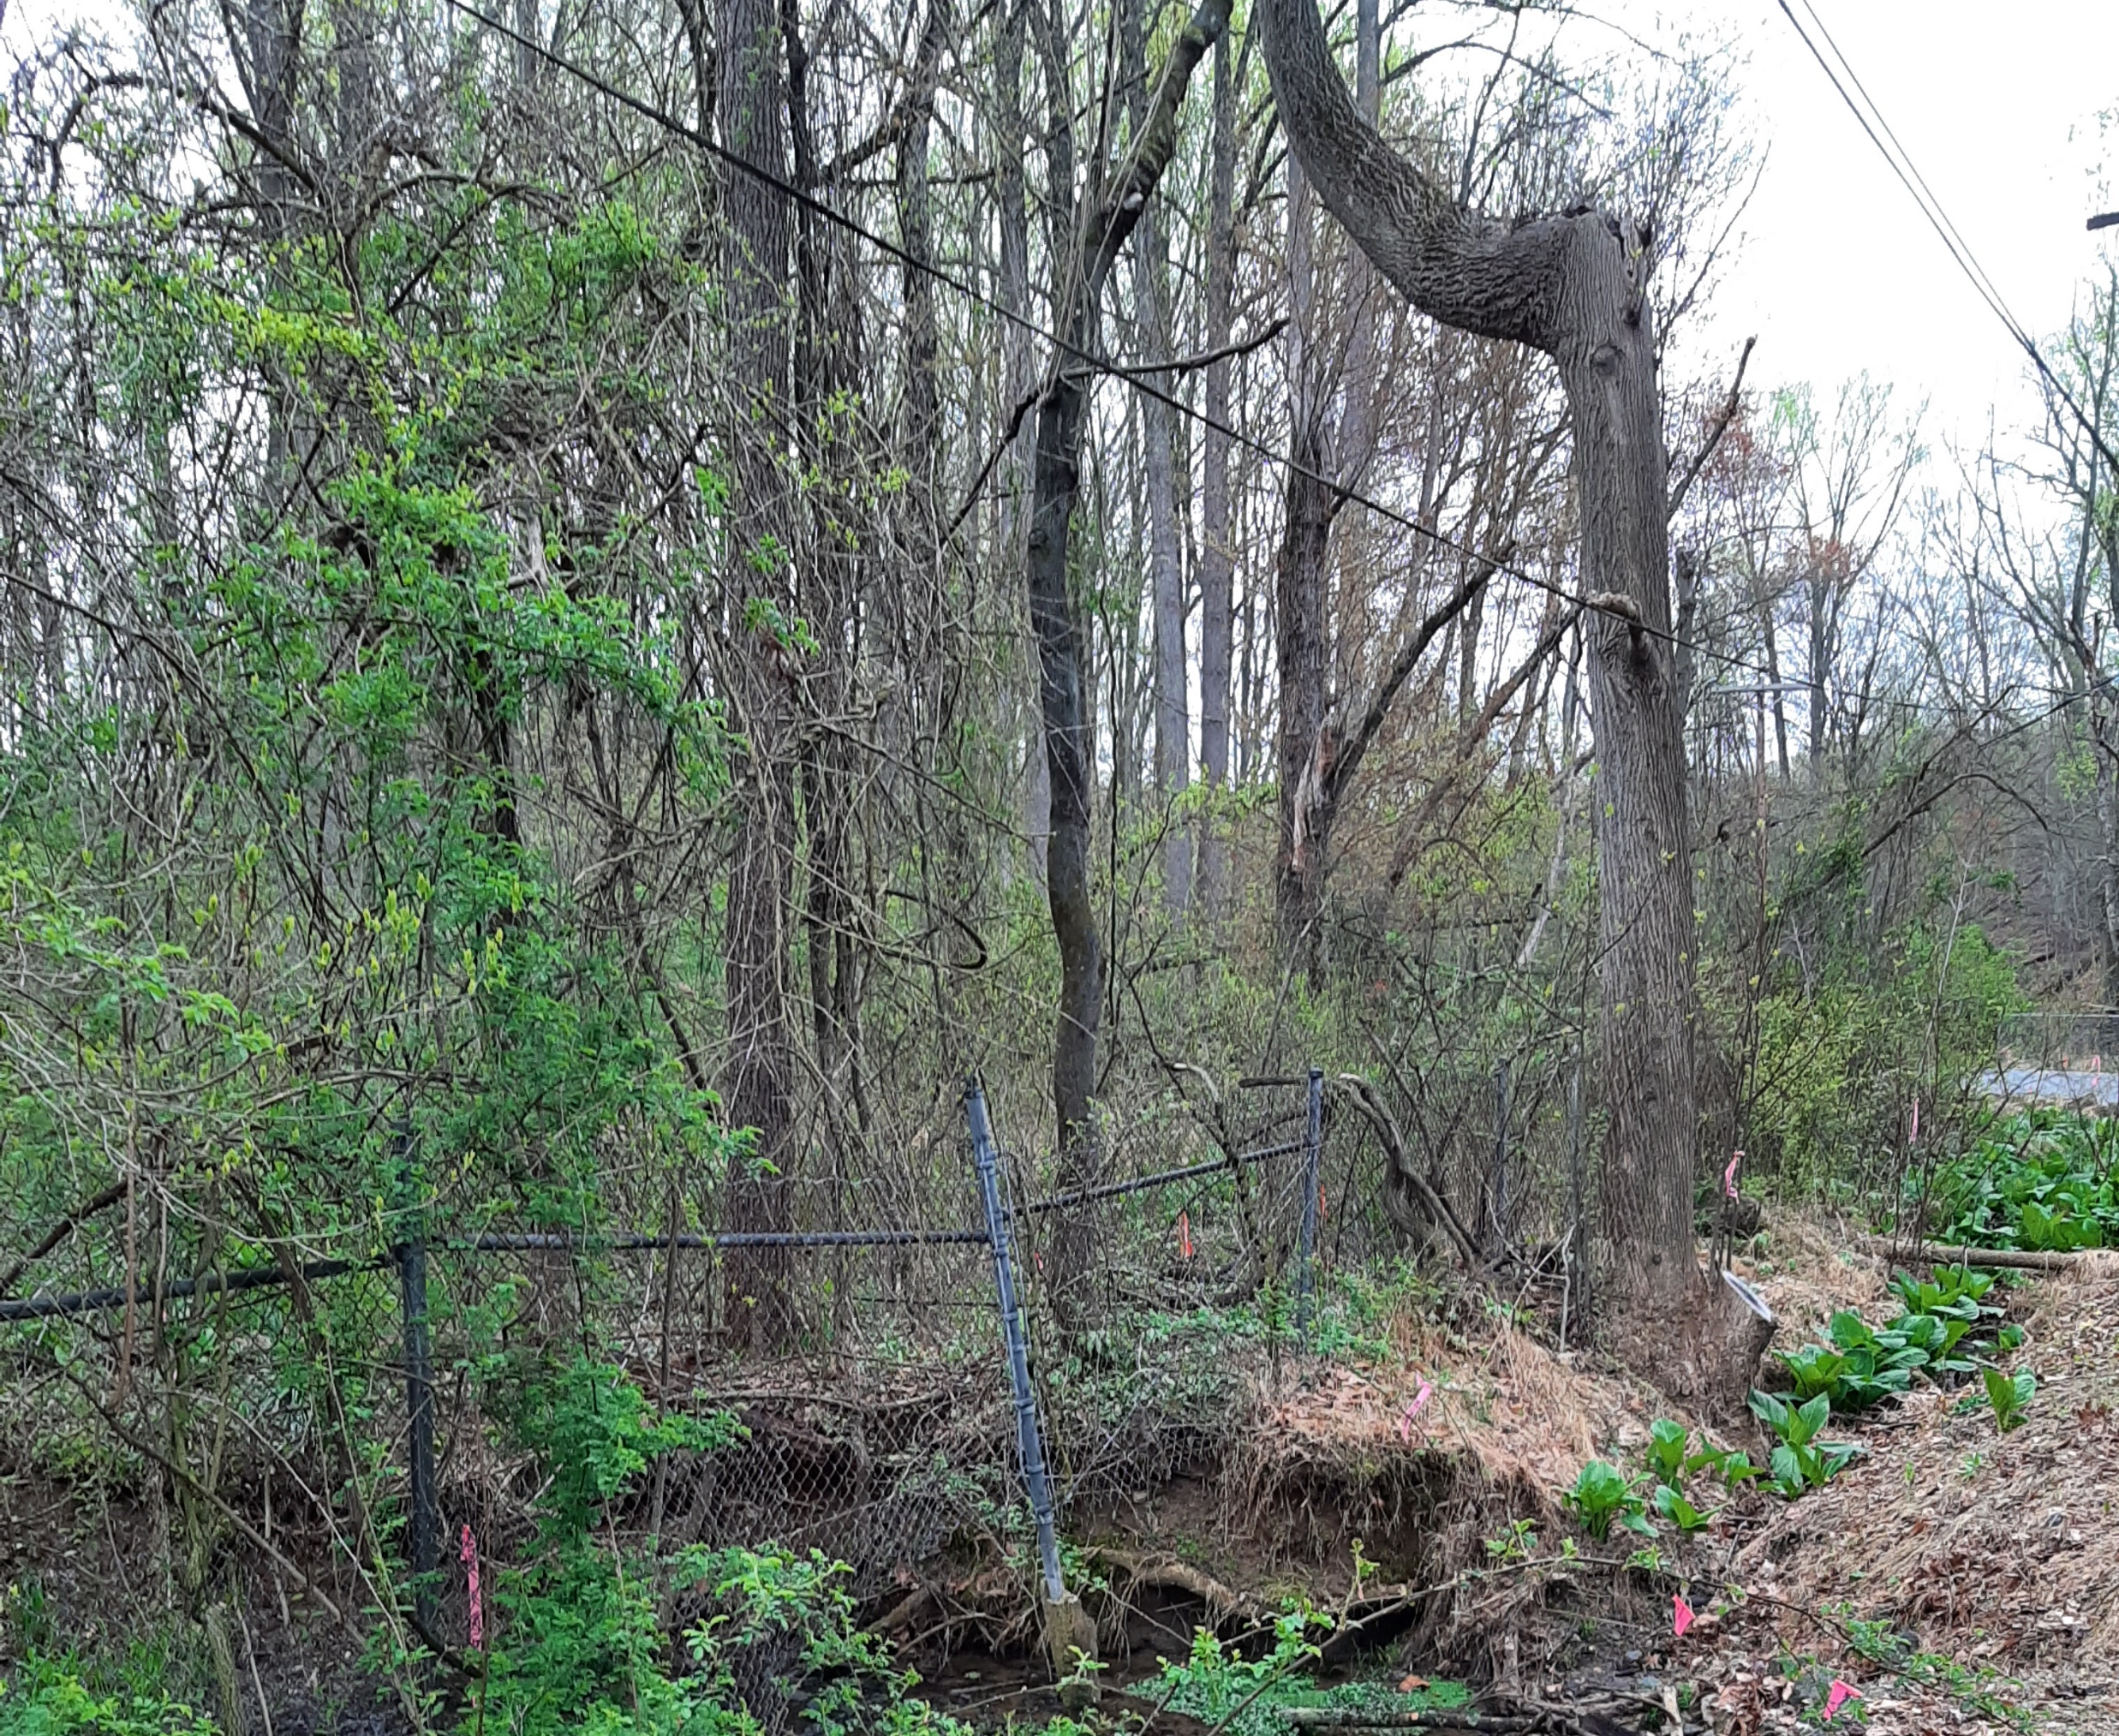
BR 1-086 on Pyles Ford Road
Tight, vegetated site conditions.

Slide 20
Project Challenges
This project was placed on hold on July 25, 2014.
In 2019, the conditions of the bridges became critical and the road was closed.
Our bridge section considered closing the road permanently, but the residents wanted it to be reopened.
Replacing the culverts presented some challenges.
Wetlands
Historical Triangle Bridge
The Infamous Bog Turtle

Slide 21
Aerial Utility Relocations
Aerial utilities only
All agreed to relocate their facilities in the fall of 2020 while the road was closed.
DelDOT’s Roadside Control used their open-end contractor to perform the required clearing.
Delmarva Power began their relocations on September 28, 2020 and completed October 7, 2020.
Comcast began on October 12, 2020 and completed on October 14, 2020.
Verizon began on October 19, 2020 and completed on October 27, 2020
All utility work was completed quicker than the 60 days as originally estimated.
Many thanks to Angel Collazo (DP-E), Kevin Lane (DP-E Constr.), Darren Marsteller (Comcast/Americomm), Joe Keenan (Verizon), and Kevin Haynesworth (Verizon).

Slide 22
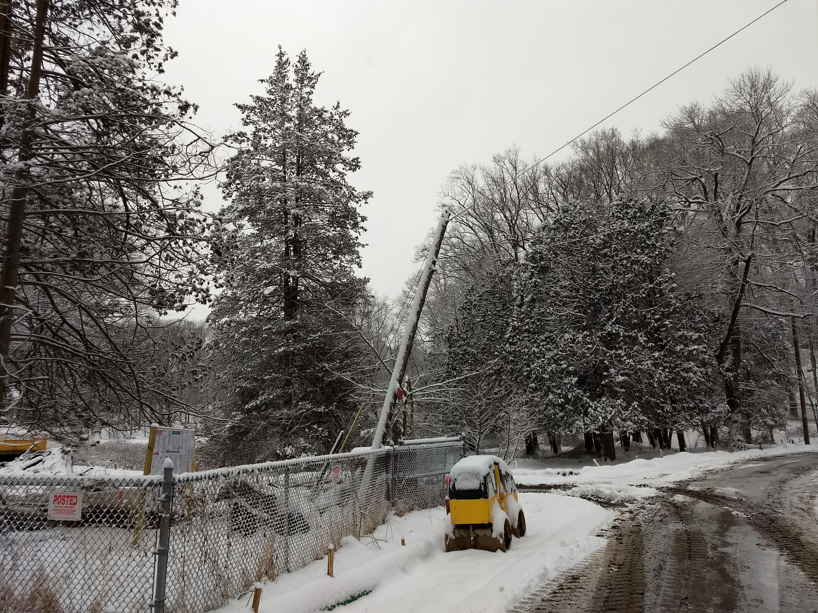
Construction of the Culverts
Currently the culverts are under construction.
As always, things happen.
February 11, 2021, DelDOT’s Area Engineer, Raj Sinha, contacted DPL’s Kevin Lane concerning a guypole that was almost in a “state of falling over.”
Kevin responded quickly and arrived that day to find DelDOT’s contractor had equipment blocking access.
Though the Delmarva Crews left, they returned the next day to secure the pole.
Thank you again for all your help Kevin!

Slide 23
BR 3-150N&S on SR1 over Lewes Rehoboth Canal
The project involved the replacement of the concrete deck on Bridge 3-150S and deck patching on Bridge 3-150N. Additional work included replacing the approach slabs and correcting the vertical alignment, replacing the joints, repairing concrete spalls throughout the substructure, and sealing the concrete abutments and piers. Project was bid as CM/GC.

Slide 24
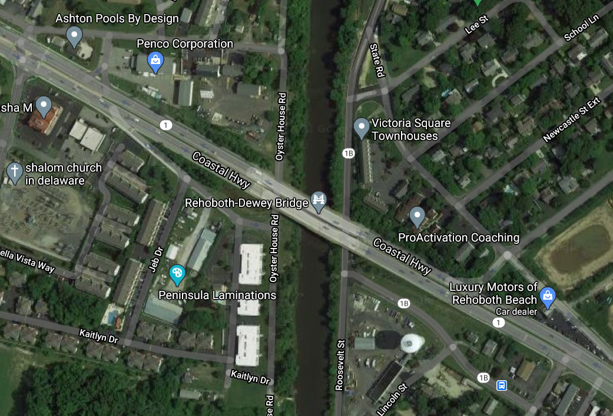
Aerial Facilities over Lewes/Rehoboth Canal
October 3, 2018, KCI (for Verizon) proposed to install a new aerial crossing over the Lewes-Rehoboth Canal on the east side of SR-1 replacing the multi duct system that was inside of the old bridge.
On October 18, 2018, the CM/GC team sent their response and rejected Verizon’s design.
The CM/GC was planning to set the cranes on the east side and Verizon’s proposed lines would be in the way.
Construction could not use the west side due to the existing DP&L Transmission and Distribution aerial facilities.

Slide 25
Verizon’s Revised Relocation Plan
KCI redesigned the aerial relocation to use existing DelDOT lighting poles on the west side SR-1 paralleling the Delmarva Power facilities.
For Verizon to attach to the pole line, they had to replace the DelDOT lighting poles with taller ones and allow DelDOT to re-attach lighting.
Had the CM/GC not been involved in the design phase, Verizon may have had to perform two moves to allow the work on BR 3-150 to proceed.
Thanks to Comcast for performing their advanced relocation work quickly!

Slide 26
Avoiding Utilities
Once in awhile, DelDOT has a project that avoids the existing utilities. This next project went like a charm.

Slide 27
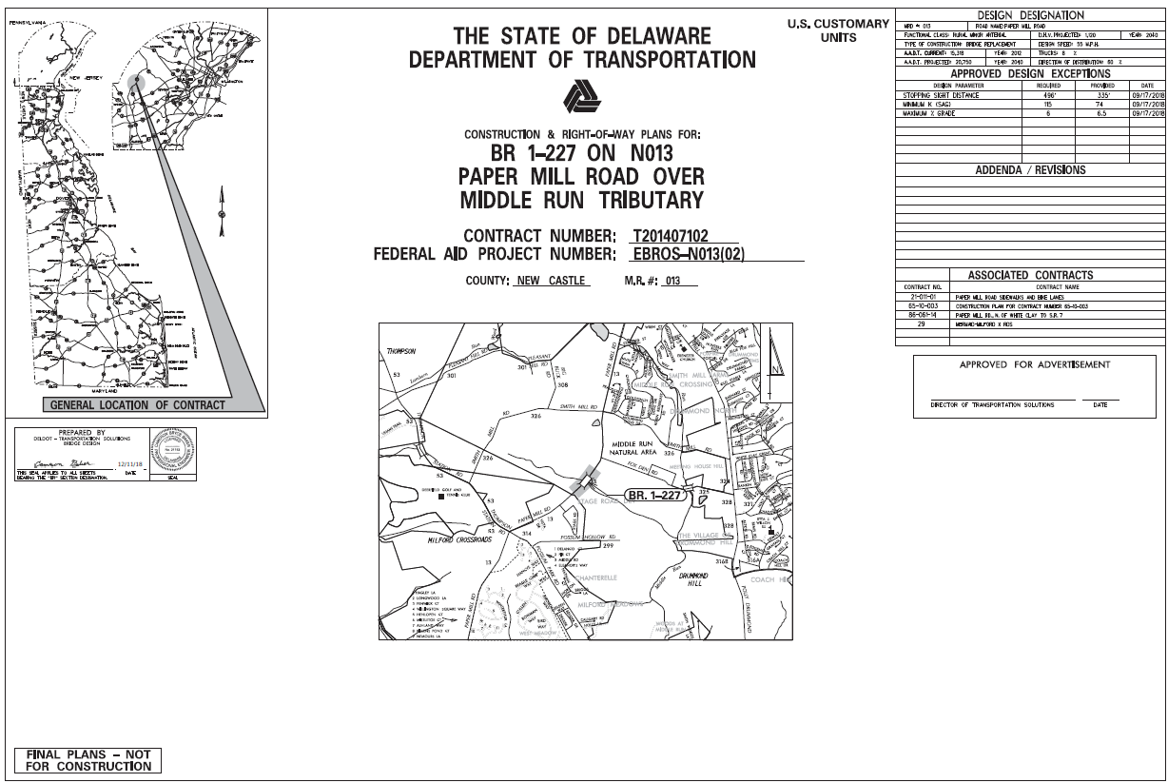
BR 1-227 on Paper Mill Road over Middle Run Tributary
This project involved the rehabilitation of a large corrugated metal pipe arch with a centrifugally cast concrete pipe arch. A separate box culvert was constructed to connect the adjacent bike trail in the parks on each side of the road. The approach roadways, guardrail, and drainage were reconstructed as needed and riprap was placed in the stream for scour protection. The work was performed in a manner which minimized impacts to traffic as much as possible.

Slide 28
The Bridge and Utilities
The existing pipe was installed in the 1960’s at the bottom of a hill with fill over top to level the road. The invert of the pipe is approximately 18 feet below the road.
The original design anticipated replacing the corrugated pipe.
At first glance, the aerial lines seemed to be out of the way. However, it was deceiving. They were closer than everyone thought.

Slide 29
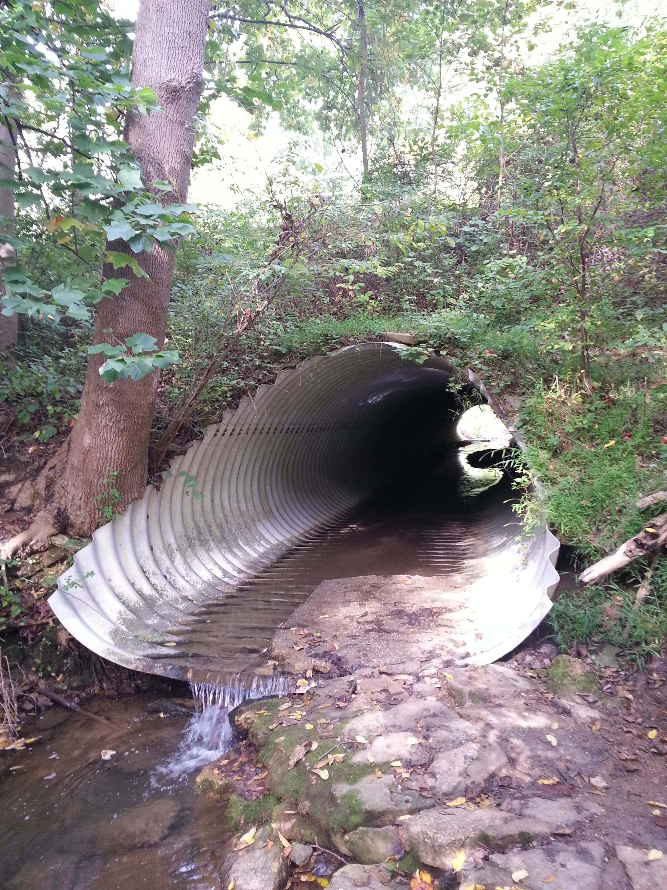
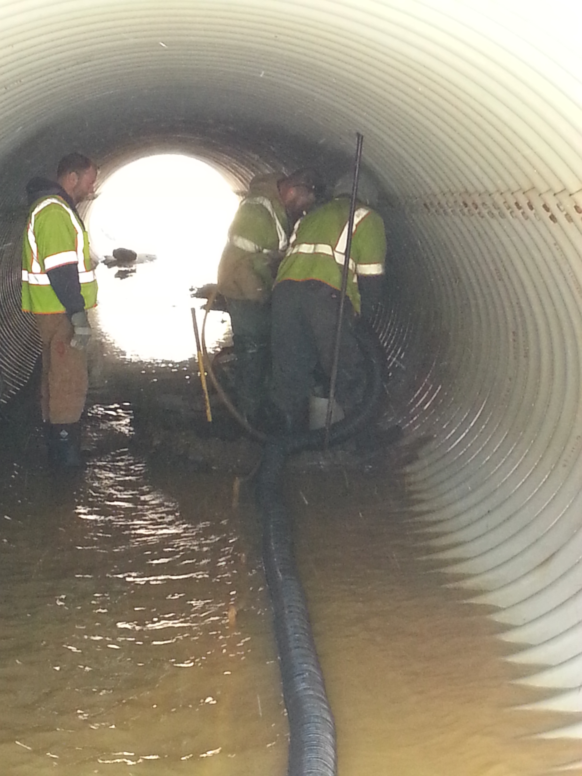
Extent DelDOT Went to Find the Utilities
To add to the challenge, there was a 16” steel transmission gas main directly under this pipe.
Early attempts were made to locate it, but they were unsuccessful. The asbuilts and archive bridge plans showed the gas main going under, but it was difficult to find.
The SUE Consultant jestingly suggested cutting corrugated pipe to locate the main. DelDOT’s bridge engineer gave them permission and it turned out to be a success. The gas main was found about 3 feet below the bottom of the pipe.
The famous test hole was done on February 4, 2015 and I believe it was the coldest day that year. Brrrrr!

Slide 30
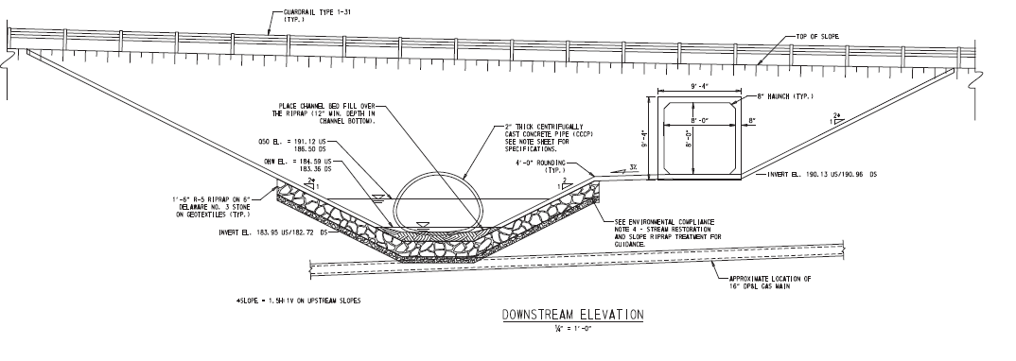
Final Bridge Design
The gas main presented many design challenges to the DelDOT’s bridge section, so they decided to keep it in place and line it with concrete.
To provide a safe crossing between the two parks, a pedestrian culvert was built at a higher elevation.
This saved the 16” steel gas main from being relocated.

Slide 31
Minimal Impacts
DelDOT’s bridge section brought in a CM/GC for the project.
Their main concern was placing the new wingwalls.
To place them, the crane would be within the 10-foot radius of the aerial electric lines.
Through coordination with Delmarva Power Electric, we were able to obtain a 24-hour outage.
As with every project, we had a few hiccups.
The culvert pre-fabrication was not completed on time. Therefore, the original outage was delayed from October 2019 until April 2020.
By changing the design and thinking of alternatives, DelDOT was able to minimize the utility involvement.
Construction took place and the project was completed June 2020.

Slide 32
At this time, DelDOT has a few projects with utility inspectors on site that were not mention previously.
The projects are:
SR72, McCoy Road to SR71: Dane Mayorga (Century) is on site and working through this everchanging project.
Elkton Road: Larry Miller (KCI) is still working on site and assisting the State’s contractor as the roadway widening is being constructed.
SR 299, SR1 to Catherine Street: Kendall Robinson (Century) is currently on site as the utilities are relocating.
These gentlemen are doing a fantastic job and deserve to recognize them for a job well done.
Utility Inspection
DelDOT has agreements with different consultants to hand the day-to-day inspection of advanced utility relocations.
When utilized, these inspectors are on site every day while the utilities are working.
They are tasked with keeping a daily log outlining who is working, site conditions, work performed, etc.
They can answer questions & address issues quickly to keep work moving.
We are finding that it is working well with projects currently under construction.
This has helped take the burden off DelDOT by providing knowledgeable people that understand the utility business.

Slide 33
Finally…..
We are all trying to work toward a common goal and the best way to achieve this is COMMUNICATION.
We at DelDOT are continuing to keep the lines of communications open and will help in anyway we can.
Living in the world of COVID-19 restrictions, we have not been able to offer the trainings we would like to provide. Hopefully, we can schedule them soon.
Remember…….

Slide 34
Thank you! February 23, 2021

